Slide 1

Customer churn Prediction (banking industry)
Institute of Data – Capstone Project
Sebastian Giunta (Data Analyst)
Notes:
Welcome audience
Project on predicting customer churn, specifically in the banking industry – product is credit cards

Slide 2

Agenda
- About Me
- Business Problem/Question
- Dataset
- Insights
- Modelling
- Conclusion
- Banking Industry Overview
- Data Question
- Pipeline
Notes:
- Walk through agenda

Slide 3
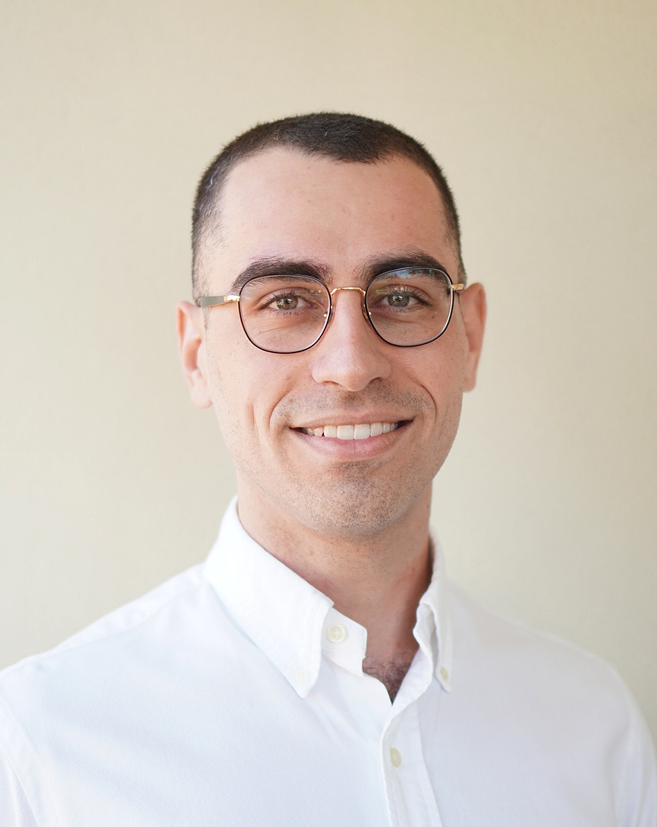
About Me
Education
Bachelor of Applied Finance (2015 Completion)
Professional Certificate, Data Science (Currently undertaking)
Professional Experience
Operations - Macquarie Bank (2016-2022)
Data Analyst - Purpose Bureau (2022 – Present)
Data Science Journey
June 2021 – Begun self study
Feb 2022 – Data Science, Professional Certificate (Institute of Data)
Notes:
Talk through points on slide
Professional experience in the banking industry drew me to tackling this problem

Slide 4
Agenda
- About Me
- Business Problem/Question
- Dataset
- Insights
- Modelling
- Conclusion
- Banking Industry Overview
- Data Question
- Pipeline

Slide 5

Banking Industry Overview
Key Statistics _{(1,2)}
97 Banks in Australia
197, 435 People Employed
19.5 million Customers
3.3 million Shareholders
$10.9 Trillion Industry (June 2021)
92% Australians Banked online (June 2021)
Primary Stakeholders
Banks (CBA, ANZ, Westpac, NAB)
Employees
Management
Bank Customers
Shareholders
Notes:
Emphasis on Stakeholders
Why is this area interesting?
It’s a large competitive industry in Australia, I believe banks that invest in AI/ML practices can find that competitive edge

Slide 6
Agenda
- About Me
- Business Problem/Question
- Dataset
- Insights
- Modelling
- Conclusion
- Banking Industry Overview
- Data Question
- Pipeline

Slide 7
Business Problem & Question
Changing banking landscape impacts customer acquisition and retention
Alternative financing platforms (digital/neo-banks)
Digital Disruption – Reduced switching costs
Ease of access
Reduced customer loyalty
Customer Acquisition cost 5-6x greater than Customer Retention cost
Customer Churn → Propensity of customers to cease doing business with a company in a given time period
Reduction in Customer Churn rate:
Reduced costs
Increased revenue
Increased customer satisfaction
How can a bank reduce it’s customer churn rate, and reap the benefits of doing so?
Notes:
Customer Churn impacts bottom line
Can a bank successfully reduce this rate and improve the bottom line

Slide 8
Agenda
- About Me
- Business Problem/Question
- Dataset
- Insights
- Modelling
- Conclusion
- Banking Industry Overview
- Data Question
- Pipeline

Slide 9
Data Question
Can we build a machine learning model that will successfully predict whether a current customer is likely to churn or not?
This prediction could then be used to intervene and attempt to prevent the customer from churning.

Slide 10
Agenda
- About Me
- Business Problem/Question
- Dataset
- Insights
- Modelling
- Conclusion
- Banking Industry Overview
- Data Question
- Pipeline

Slide 11
Dataset
Data on 10,127 credit card customers, each with 20 features, over 12 month period.
Customer Churn
Yes/No
Demographics
Age/Gender/Num Dependents/Education/Marital Status/Income
Bank Relationship
Card Category/Period of Relationship/Products Held/Num Times Contacted/Credit Limit
Activity
Months Inactive/Card Balance/Transaction Amount & Count/Change in Transaction Amount & Count (Q4 over Q1)/Open to Buy Credit (Average)/Card Utilisation Ratio (Average)
Data Quality
Mostly complete information on each customer
Ambiguous explanation of some features
Unknown Values:
Education (1,519)
Marital Status (749)
Income (1,112)
Sourced from Kaggle
Future models would benefit from larger private bank data
Notes:
Ambiguous Explanation → Limited by the information provided on Kaggle. I.E. ‘Open to Buy Credit (Average)’ wasn’t entirely clear on it’s exact meaning.
Decision was made to leave Unknown values in dataset for initial model building. Note these were coded as the string value ‘Unknown’.

Slide 12
Agenda
- About Me
- Business Problem/Question
- Dataset
- Insights
- Modelling
- Conclusion
- Banking Industry Overview
- Data Question
- Pipeline

Slide 13
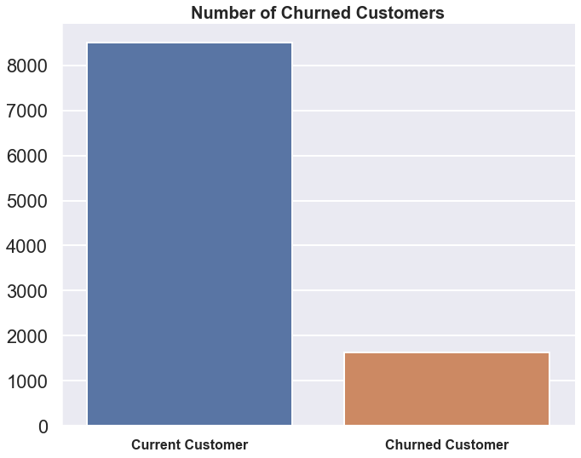
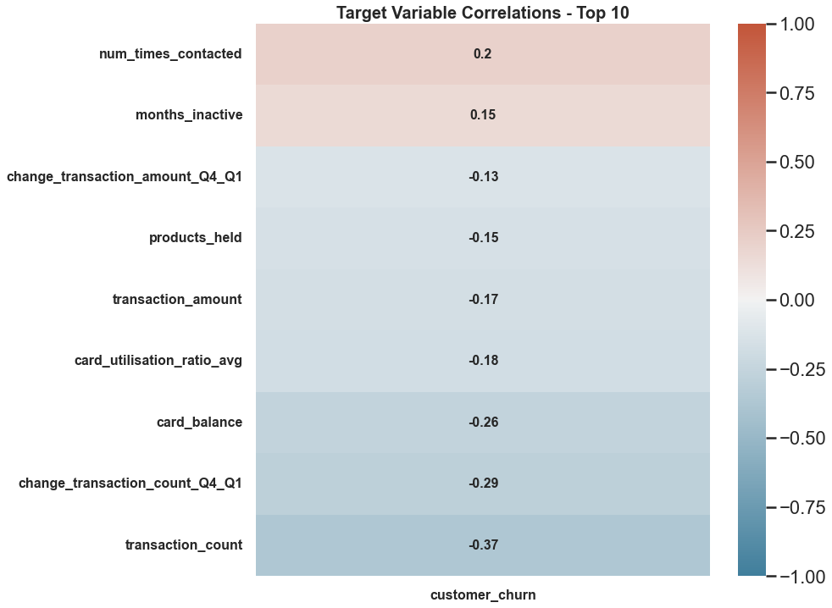
Insights
8500 (84%)
1627 (16%)
Churned customer represents a customer that has closed accounts with the bank
Lower proportion of these customers relative to current customers (Imbalance)
Number of times contacted highest positive correlation
Transaction Count highest negative correlation
Notes:
First graph represents our ‘Target Variable’ – Imbalance can be addressed using sampling techniques
Second graph highlights of Categorical Features – Will be encoded

Slide 14
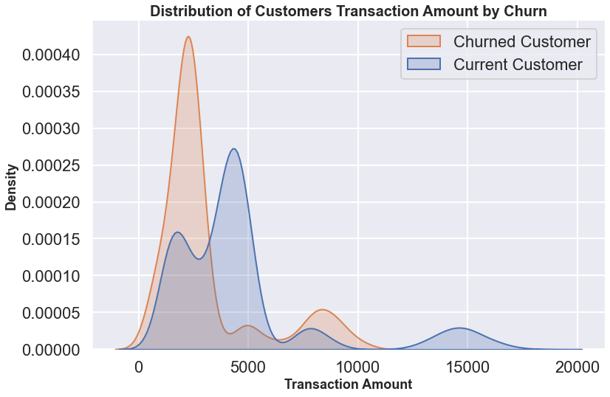
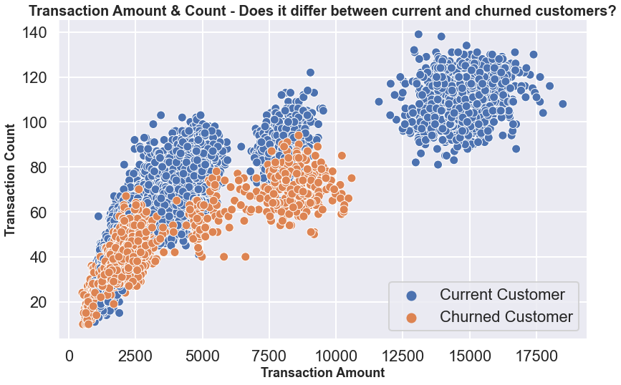
Insights
Multimodal distribution
Lower transaction amount → Higher chance of customer churn
High transaction amount → Loyal Customers
Clear distinction between two groups
Churned customers have lower activity and spend less
Loyal customers spend higher amounts
Notes:
Multiple groups based on customers transaction amount
Customers that spend more than roughly 12k don’t churn
Strategy Development → Don’t want to overcontact customers that have been identified to churn

Slide 15
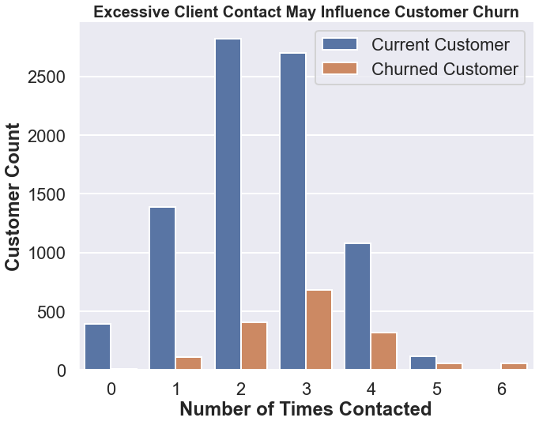
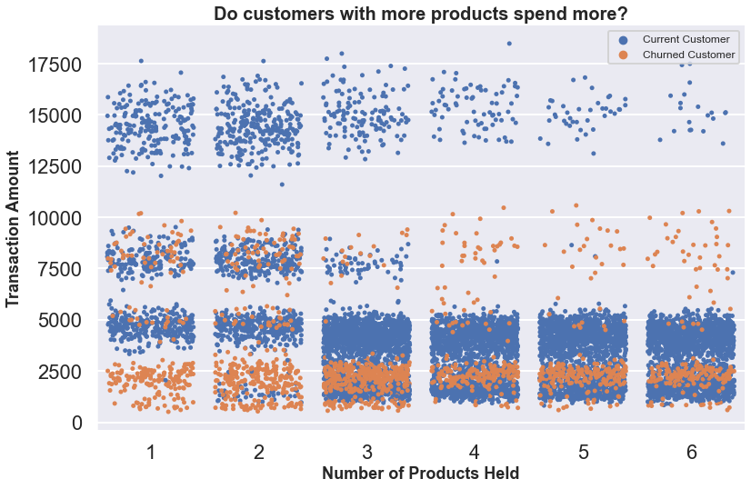
Insights
Excessive contact → Increased customer churn as a relative proportion
Customers with 1 or 2 products that spend under $3000 are likely to churn
More products doesn’t mean higher spend

Slide 16
Agenda
- About Me
- Business Problem/Question
- Dataset
- Insights
- Modelling
- Conclusion
- Banking Industry Overview
- Data Question
- Pipeline

Slide 17
Pipeline
Cleaning
Exploration
Modelling
Interpretation
Feature Engineering
Renamed & Dropped Columns
Missing Value check
Visualisation for insights
Summary Statistics
Encoding (OrdinalEncoder & get_dummies)
Train/Test Split
Pipeline (Standardise & Sampling Techniques)
Baseline comparison
Sampling comparison
Model Selection
Hyperparameter Tuning
Application of metrics to business problem
Recommendations
Notes:
No missing values; only ‘Unknown’ string values
Encoding (Ordinal & Pandas Get Dummies)
70/30 Train Test Split
StandardScalar
Sampling Techniques on coming slides

Slide 18
Agenda
- About Me
- Business Problem/Question
- Dataset
- Insights
- Modelling
- Conclusion
- Banking Industry Overview
- Data Question
- Pipeline

Slide 19
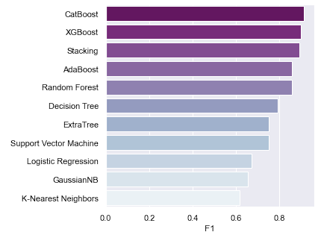
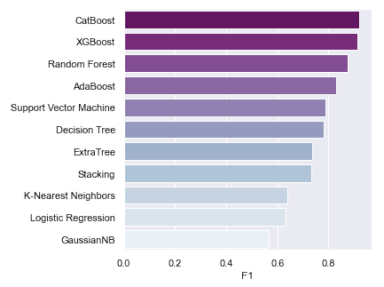
Modelling
Baseline
Random Over Sampler
Trained on all 19 features
Models trained on 7,088 customers
Models tested on 3,039 customers
Evaluation Metrics = F1 & Recall
F1 → Imbalanced Data
Recall → Maximise identification of customers that will churn
Sampling techniques tested:
Random Over Sampler (Highest Performance)
Random Under Sampler
SMOTE
Notes:
Objective is to find customers that may churn, and intervene to prevent the churn.
False Positive (Model Says Churn, but Customer Loyal) → Little impact to business
False Negative (Model Says No Churn, but Customer Leaves) → Larger impact to business
Ensure high Recall Score
Though F1 score also to be taken into consideration due to imbalanced data

Slide 20
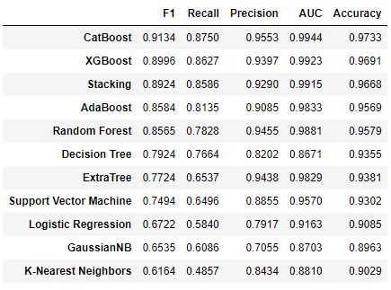
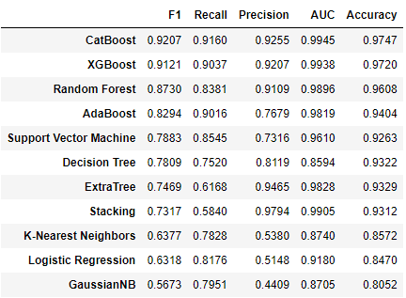
Modelling
Baseline
Random Over Sampler
Oversampling improved Recall
5-Fold Cross Validation - CatBoost, XGBoost, Random Forest and AdaBoost
CatBoost highest performer → 0.9134 average F1 Score
Notes:
- Performed 5-Fold Cross Validation to give more confidence to decision of using CatBoost as final model

Slide 21
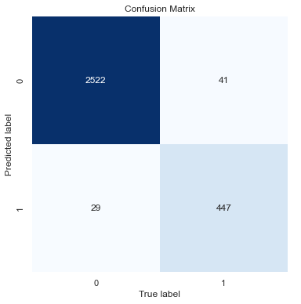
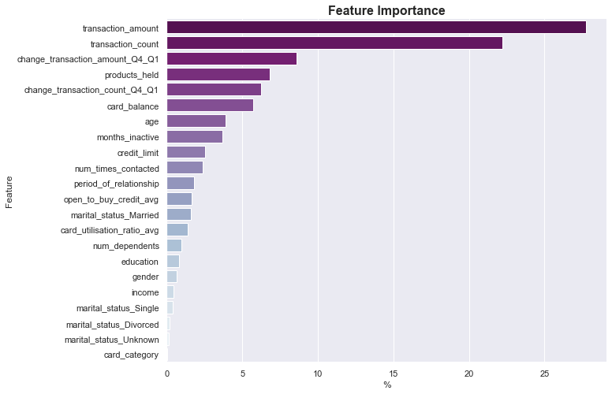
Modelling
Results After Tuning
Metrics | Test Score
F1 | 0.9274
Recall | 0.9160
Precision | 0.9391
AUC | 0.9953
Accuracy | 0.9770
Minor increase after fine tuning the model
Possible to increase Recall at expense of Precision
Model correctly identified 447 out of 488 customers that churned (Recall)
Successful churn prevention of correctly identified customers will reduce costs
Customers activity is the most important in predicting a customer churning
Notes:
Tuning increased all scores except Recall

Slide 22
Agenda
- About Me
- Business Problem/Question
- Dataset
- Insights
- Modelling
- Conclusion
- Banking Industry Overview
- Data Question
- Pipeline

Slide 23
Conclusion
Summary
Actively seeking to reduce customer churn, the bank can improve it’s bottom line
Explored insights into customer activity and how this influences their likeliness to churn
Successful building of a high performance CatBoost Model (F1 = 0.9274 & Recall = 0.9160) to predict customer churn
Predictions can be used to then try prevent customers from churning
Key Recommendations
Implement model quarterly to predict customer churn (MLOps)
Apply pre-determined prevention strategy on customers that have been flagged by the model
Lower Interest Rates
Special Offers
Consistently provide incentive for customers to use the banks products more, increasing transaction activity
Notes:
Talk summary in retrospect

Slide 24

Conclusion
Next Steps
Principal Component Analysis (PCA)
Imputing ‘Unknown’ Values
Further fine tuning to increase Recall at expense of Precision
Obtaining a larger set of data to re-train model
Notes:
PCA for dimensionality reduction; allow for a faster model
‘Unknown’ values could be imputed using classification to predict likely value
Explanation to business that the model can be tuned to increase Recall (Reducing False Negatives)
Sourcing larger and better quality data

Slide 25
References
https://www.ausbanking.org.au/insight/banking-by-the-numbers/
https://www.roymorgan.com/findings/8773-financial-services-market-june-2021-202108170239

Slide 26
Thank you
GitHub Repo

